Slide 1
Bootstrap 2

Slide 2
Some Further classes &
Some Very Cool …
Text
  Aligning text within a container
  Bold, italics & wrapping within a container
Rounding and placing a shadow on a container
Images
  Fluid sizing and thumbnail
  Figure element classes
Automatic grids
Pre-Made Components
Accordion
Breadcrump
Buttons, button groups & dropdown buttons
Card
Carousel
Navbar

Slide 3
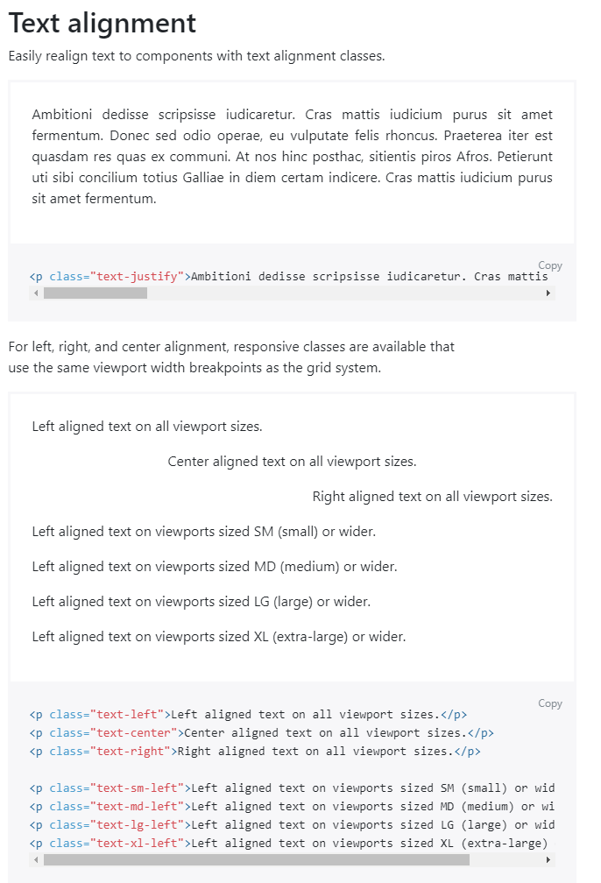
Text Alignment Classes
text-left, text-center, text-right, text-justify
  Can also be connected to breakpoint widths such that the alignments happened with sm, md, lg, xl (or wider)

Slide 4
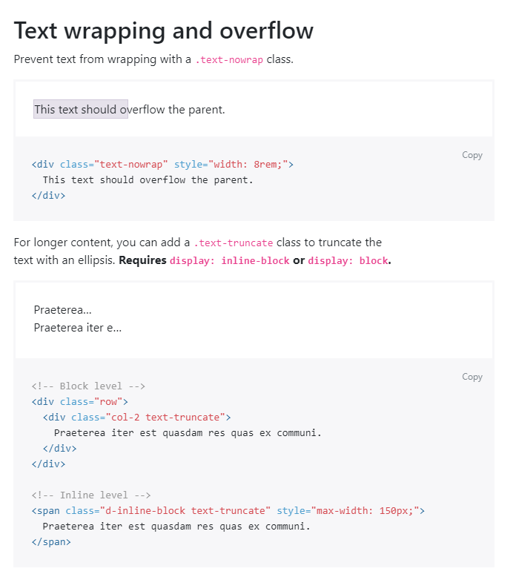
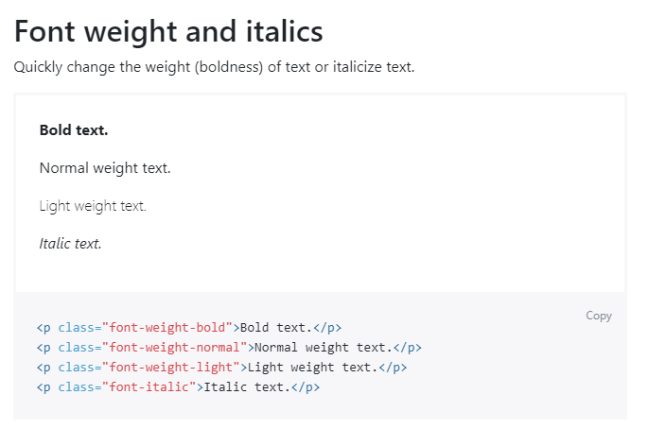
More text

Slide 5
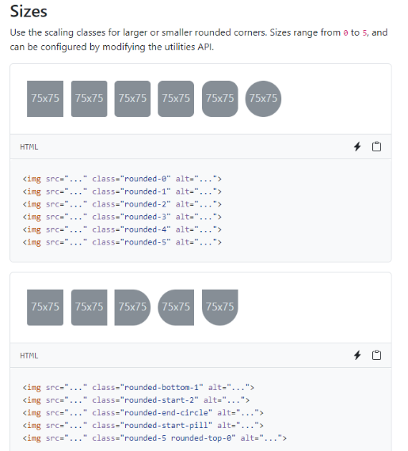
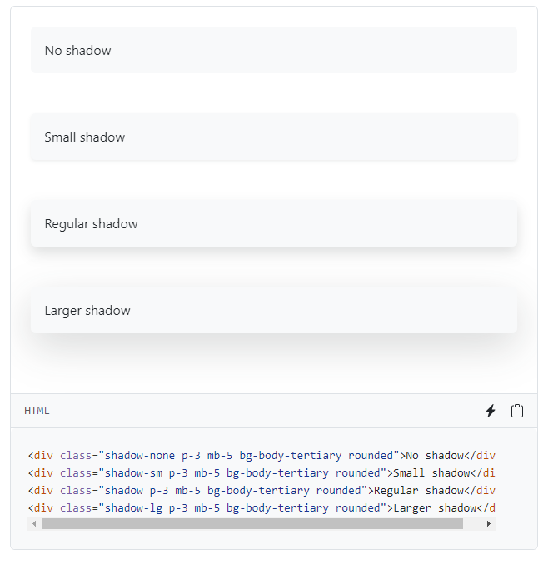
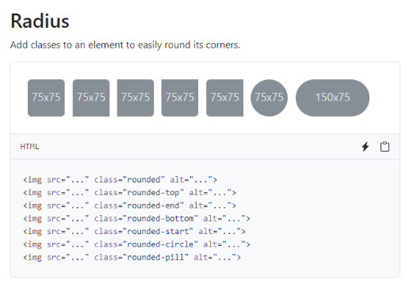
Other interesting classes that could be used with images (or other things)
rounded
  Position, style, & size
Shadow
  Size

Slide 6
Images: Fluid & Thumbnails
<img src="..." class="img-fluid" alt="...">
  Responsive, automatically max-width:100% and height:auto so that image scales with parent.
<img src="..." class="img-thumbnail" alt="...">
  Image presented with rounded 1px border when its sources is pre-existing cropped version of the image.
If you are using the <picture> element to specify multiple <source> elements for a specific <img>, make sure to add .img-* classes to the <img> and not to the <picture> tag.

Slide 7
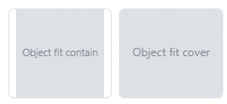
Object Fitting
Elements like <picture> <img> <video> should be resized to fit its container
Default fit-fill: provided dimensions used so can be stretched or squished.
Better:
  Cover: aspect ratio kept
  BUT image clipped to fit its container
  <img src="..."
  class="object-fit-cover
  border rounded" alt="...">
  Contain: aspect ratio kept
  BUT image resized to fit its container
  <video src="..."
  class="object-fit-contain
  border rounded" alt="...">

Slide 8
Figures (and their captions) with the figure classes
When using these semantic elements, use the Bootstrap classes
  .figure
  .figure-img
  .figure-caption
Notes:
  <figure> are semantic and have not implicit size → use <img class='img-fluid'…> to make the images responsive.
  Combine figure-caption with text-left, text-center, or text-right to place the caption where you want.
<figure class="figure">
<img src="..."
class="figure-img img-fluid rounded"
alt="Image, rounded corners in figure.">
<figcaption
class="figure-caption text-right">
The caption for the above image.
</figcaption>
</figure>

Slide 9
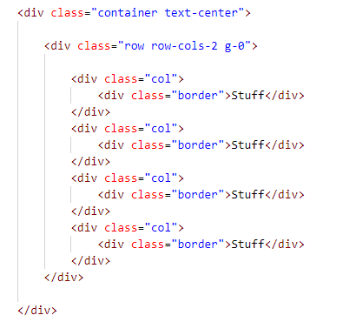
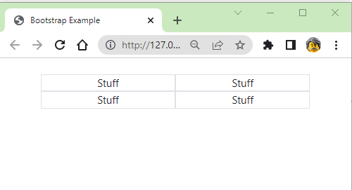
Setting Grids, A shortcut: . row-cols-*
Class that quickly sets the number of columns that best renders the content and layout

Slide 10
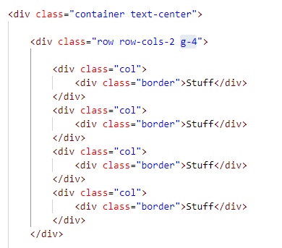
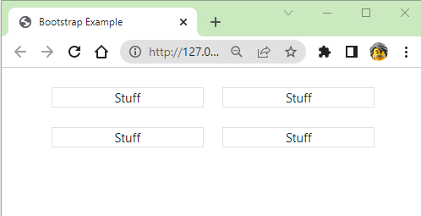
Grid Gutters: g-*
Controls horizontal gutter widths
In the example, because all columns are within 1 row, the gutter is applies throughout
Alternately:
  Apply use m-* (margin) on contents of columns

Slide 11
Fancy Pre-made Components

Slide 12
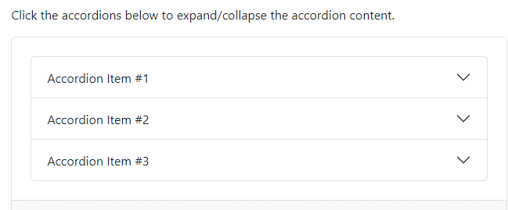
Accordion: Content is displayed or hidden (collapsed) by user actions
<div class="accordion" id="accordionExample">
<div class="accordion-item">
<h2 class="accordion-header" id="headingOne">
<button
class="accordion-button"
type="button"
data-bs-toggle="collapse"
data-bs-target="#collapseOne"
aria-expanded="true"
aria-controls="collapseOne">
Accordion Item #1
</button>
</h2>
<div id="collapseOne"
class="accordion-collapse collapse show"
aria-labelledby="headingOne"
data-bs-parent="#accordionExample">
<div class="accordion-body">
<strong>This is the first item's accordion body.</strong> It is shown by default, until the collapse plugin adds the appropriate classes that we use to style each element.
</div>
</div>
</div>
<div class="accordion-item">
<h2 class="accordion-header" id="headingTwo">
ETC.
https://getbootstrap.com/docs/5.3/components/accordion/

Slide 13
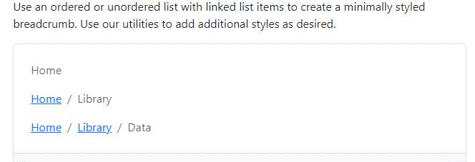
Breadcrumb:
Useful navigation to show user where they are and where they’ve been.
<nav aria-label="breadcrumb">
<ol class="breadcrumb">
<li class="breadcrumb-item active" aria-current="page">Home</li>
</ol>
</nav>
<nav aria-label="breadcrumb">
<ol class="breadcrumb">
<li class="breadcrumb-item"><a href="#">Home</a></li>
<li class="breadcrumb-item active" aria-current="page">Library</li>
</ol>
</nav>
<nav aria-label="breadcrumb">
<ol class="breadcrumb">
<li class="breadcrumb-item"><a href="#">Home</a></li>
<li class="breadcrumb-item"><a href="#">Library</a></li>
<li class="breadcrumb-item active" aria-current="page">Data</li>
</ol>
</nav>
https://getbootstrap.com/docs/5.3/components/breadcrumb/

Slide 14
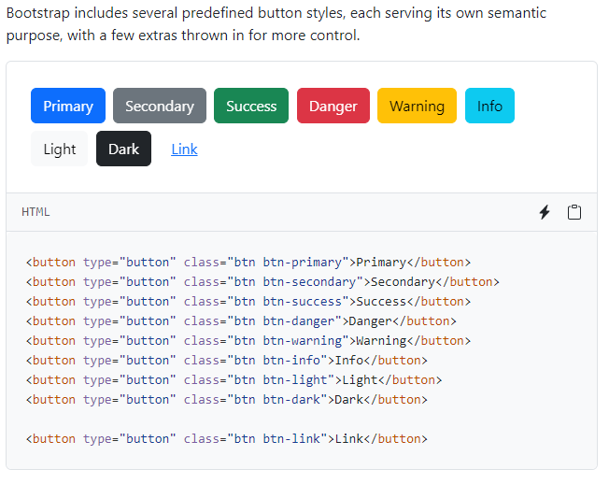
Buttons
The .btn classes can be used with <a> or <input> elements too
  <button class="btn btn-primary" type="submit">Button</button>
  <a class="btn btn-primary"
  href="#" role="button">Link</a>
  <input class="btn btn-primary" type="submit" value="Submit">
Other button classes:
  .btn-outline-*
  .btn-sm & .btn-lg
  …and more…

Slide 15

Button Group
<div class="btn-group" role="group" aria-label="Basic outlined example">
<button type="button" class="btn btn-outline-primary">Left</button>
<button type="button" class="btn btn-outline-primary">Middle</button>
<button type="button" class="btn btn-outline-primary">Right</button>
</div>

Slide 16
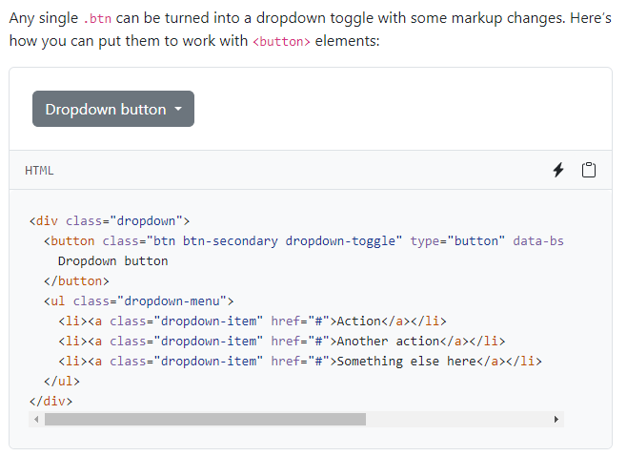
Dropdowns
Toggleable, contextual overlays that display lists (of links)
Requires the ‘Popper’ library and JavaScript CDN or downloaded resources:
  bootstrap.bundle.min.js / bootstrap.bundle.js

Slide 17
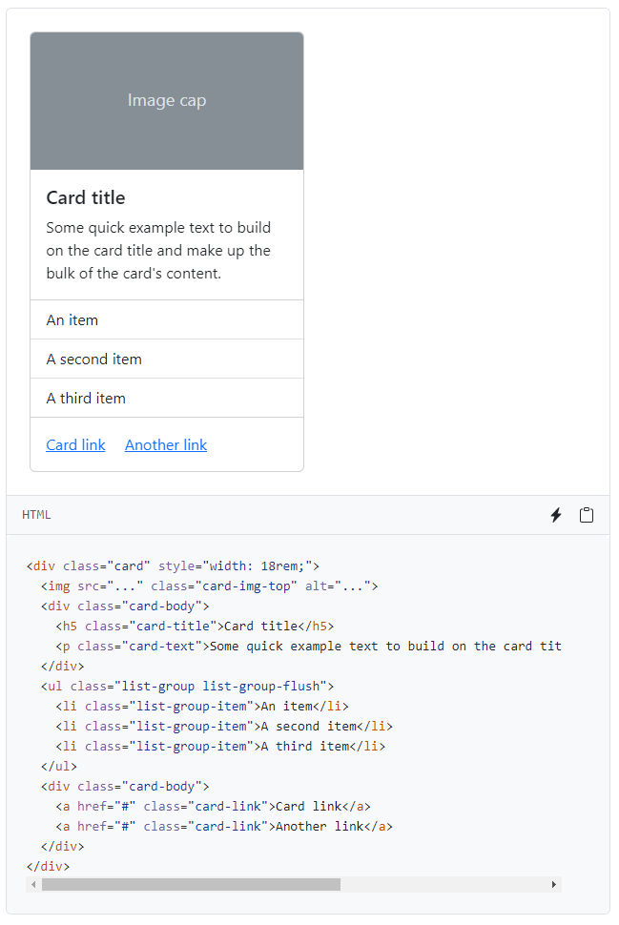
Cards
A flexible and extensible content container
  Includes headers, footers, background colors and used with a variety of content types.
Useful when combined with grid markups to give ‘previews’ to site contents.
https://getbootstrap.com/docs/5.3/components/card/

Slide 18
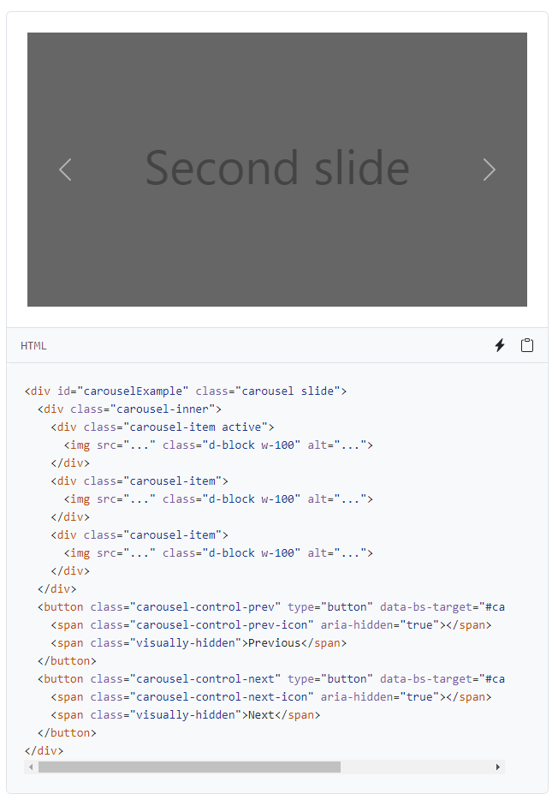
Carousel
Slideshow that cycles through content
  Requires the JavaScript CDN or download.
JBYCDMYS: these are non-trivial to implement.
https://getbootstrap.com/docs/5.3/components/carousel/

Slide 19
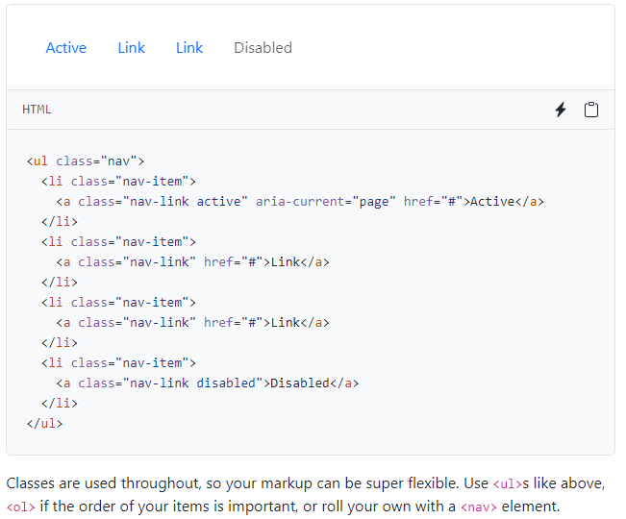
Basic Nav
Build with a flexbox
.active state does not work but can be conveyed with:
  aria-current attribute — using the page value for current page, or true for the current item in a set.

Slide 20
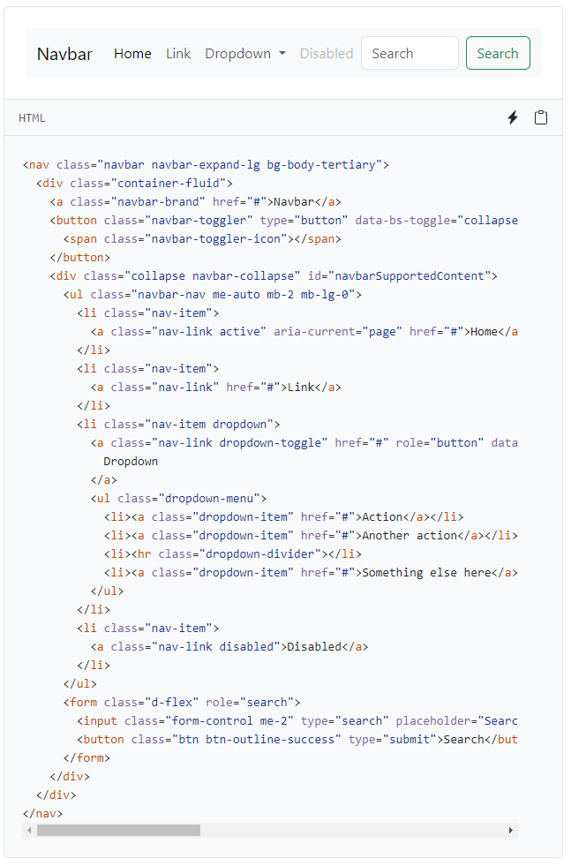
Navbar
More complicated:
  Require .navbar with .navbar-expand-{size}
Results in a fluid, responsive navigation
https://getbootstrap.com/docs/5.3/components/navbar/

Slide 21
Plus much more…
Alerts
Badges
Close button
Collapse
List group
Modal
Offcanvas
Pagnination
Popovers
Progress
Scrolspy
Spinners
Toasts
Tooltips
Just because you can,
does NOT mean you should.

Slide 22
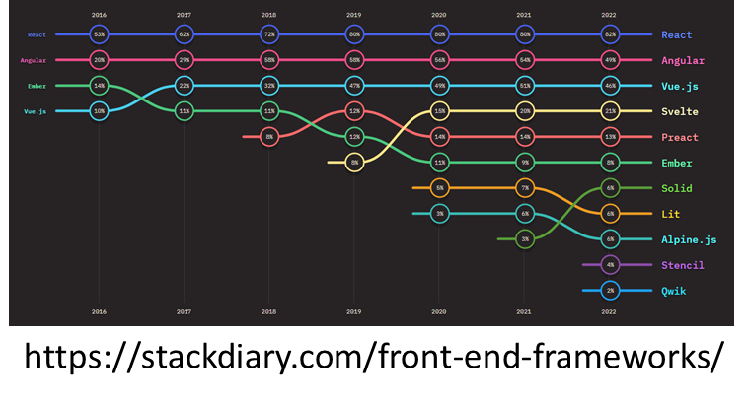
Last thoughts…
Bootstrap is not the only, nor the most common, front-end web frameworks that use JavaScript.
But getting a sense of Bootstrap will help you with other products AND your ability to work with JavaScript in Web 2

Slide 23
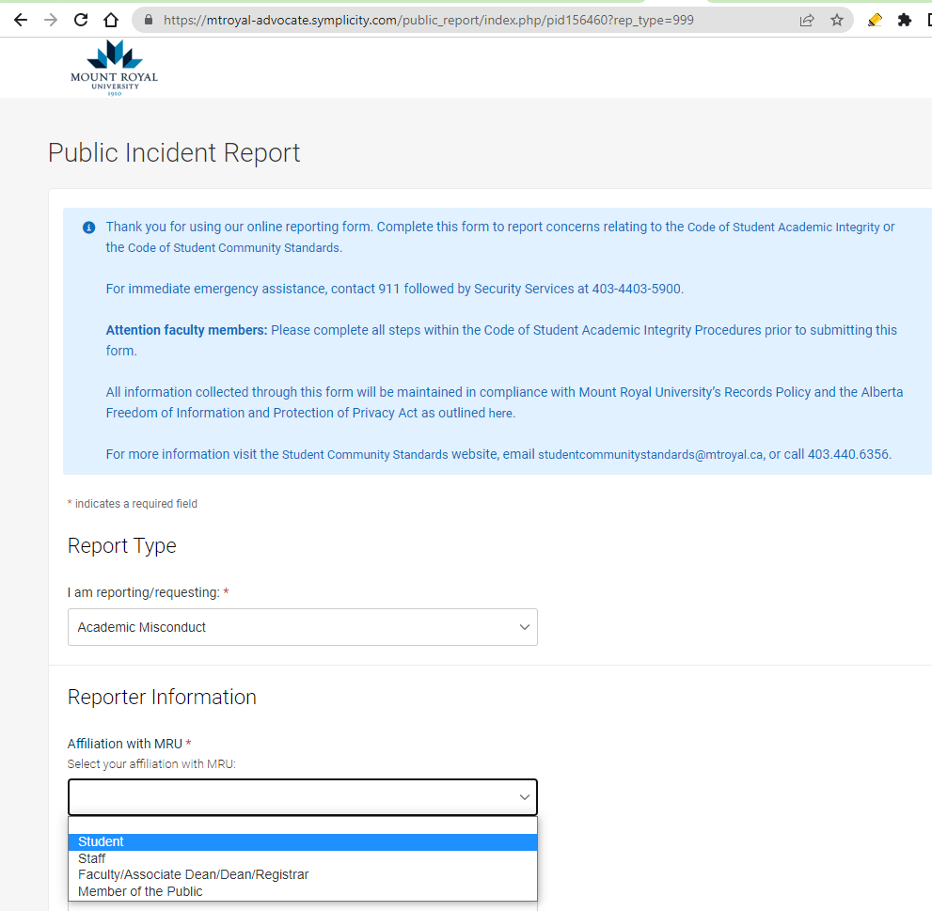
Academic Integrity means…
Recall, all content on all web sites is copyright
  text, images, music, audio, video &c.
Whether or not a layout can be copyrighted is being debated:
  Clearly ‘padding’ can’t be copyright, however
However the concept of ‘compilation’, where one demonstrates intellectual effort to combine design options in a particular way,
is considered an ‘original work’
– thus is copyright.
MOST IMPORTANTLY FOR YOU….
You’ve already agreed
you will NOT plagiarise:
  Never submit or use ideas, words, images, code, performance or work of others with out citation.
    In full or in part.
    Includes resubmitting, without permission, your own work.
And, you are formally encouraged (along with the general public) in MRU policy to report all instances.

Slide 24
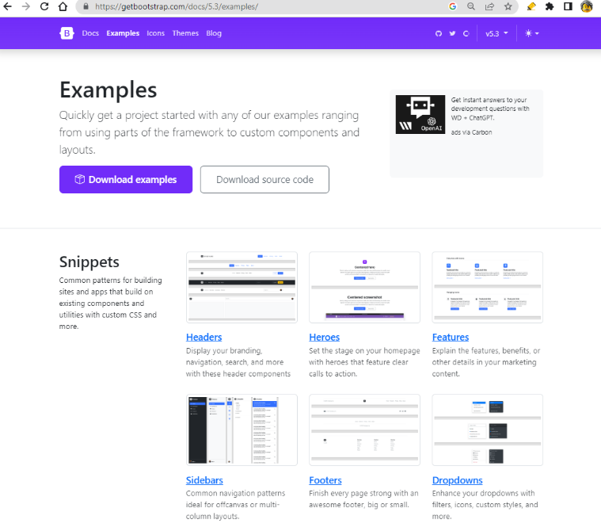
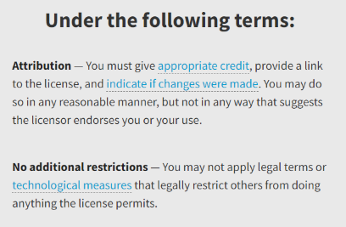
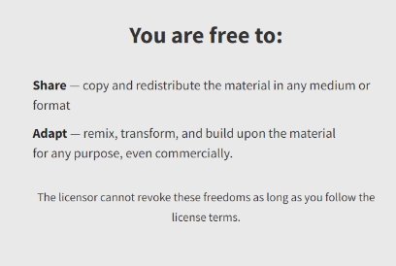
So…Bootstrap examples?
https://getbootstrap.com/docs/5.3/examples/
Cite:
  BootStrap uses Creative Commons Attribution 3.0 license
  ChatGPT or other AI:
    Reference list:
    OpenAI. ChatGPT. Chat.openai.com/. Accessed Feb 16, 2023.
    In-text: (OpenAI)

